Slide 1
FlexClass
Classes with dynamic size for everyone
“C++ Flexible Array Members”
Breno Guimarães
brenorg@gmail.com
Twitter @brenorg
https://github.com/brenoguim/flexclass

Slide 2
std::make_shared<T[]>(n)
Control Block
T
T
T
T
T
…
std::shared_ptr<T[]>(block)

Slide 3
my::shared_ptr
Control Block
T
T
T
T
T
T
…
int ref_cnt;
int size;
my::shared_ptr<T[]>(block)

Slide 4
I will write it myself ™
Control Block
T
T
T
T
T
T
…
template<class T>
auto my::make_shared(int n)
{
// Allocate sizeof(controlBlock)
+ n*sizeof(T) bytes
// Cast and initialize the control block
// Cast and initialize each T
// return my::shared_ptr<T>(block);
}
// FixMe: What about alignment?
// ToDo: Are these reinterpret_casts safe?
// CheckThis: What if T() throws?
// Why am I manipulating bytes?
// This was supposed to be modern C++

Slide 5
FlexClass
A tool in the shed

Slide 6
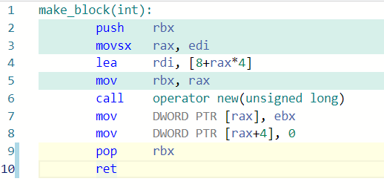
#include <flexclass.hpp>
template <class T>
struct Block
{
auto fc_handles() {
return fc::make_tuple(&data);
}
int size;
int ref_cnt;
fc::AdjacentArray<T> data;
};
template <class T>
auto my::make_shared(int n)
{
Block<T>* block = fc::make<Block<T>>(n)
// return my::shared_ptr<T>(block);
}
https://godbolt.org/z/v3hdhYnaT
auto begin = block->data.begin();
auto end = std::advance(begin, block->size);
(n, 0);

Slide 7
Features
#include <flexclass.hpp>
struct Foo
{
auto fc_handles() {
return fc::make_tuple(&h1, &h2, &h3);
}
fc::Range<std::string> h1;
fc::Array<int> h2;
fc::Array<float> h3;
};
Foo* f = fc::make<Foo>(3, 17, 8)();
Non-trivial types
Multiple arrays
Correct alignment
Exception safety
Allocators
Customizable handles
More…

Slide 8
Thank you!
Twitter: @brenorg
brenorg@gmail.com
https://github.com/brenoguim/flexclass
Also thanks FlexClass contributors: Thamara Andrade and Euller Borges

